Slide 1

RAJASTHAN TECHNICAL UNIVERSITY
DEPARTMENT OF COMPUTER SCIENCE AND ENGINEERING
MINOR PROJECT PROGRESS PRESENTATION
SUBMITTED TO:
PROF. DR. C.P GUPTA PROF. DINESH SONI
SUBMITTED BY:
PRANCHAL GUPTA (21/262) POONAM KANWAR (21/260) SAYYED AAZAM ALI (21/281)

Slide 2
Final Presentation
CALORIE BURN PREDICTION USING MACHINE LEARNING ALGORITHMS

Slide 3
Team Members
1
Pranchal Gupta
Roll No: 21/262
2
Poonam Kanwar
Roll No: 21/260
3
Sayyed Aazam Ali
Roll No: 21/281

Slide 4

Calories Burnt Prediction
In this project on calorie burn prediction, we are investigating the relationship between various health metrics such as calorie intake, gender, age, height, weight, and activity duration. So far, we have utilized Python libraries extensively, especially pandas for data manipulation and preprocessing. Pandas has helped us efficiently handle and clean the dataset, perform exploratory data analysis, and divide the data into training and testing sets on an 80/20 basis.
Additionally, we've learned and implemented matplotlib for plotting graphs to visualize the data and model performance. Functions for calculating important metrics like Root Mean Squared Error (RMSE), R2 Score, and Cross-Validation Scores have also been developed to evaluate our model. These metrics will guide us in fine-tuning the model for better predictions.

Slide 5
Content
1
Problem Statement
2
Objective
3
Machine Learning Algo And It’s Implementation
4
Exploratory Data Analysis For Provided Performance Metrics
5
Adding Different Functionalities Like Personal Goal Tracker
6
Conclusion

Slide 6
Problem Statements
Understanding Factors
This project focuses on analyzing the relationship between individual health metrics such as calorie intake, gender, age, height, weight, activity duration, heart rate, and body temperature. This project examines the relationship between various health metrics to predict specific health outcomes. Here, the independent variables (predictors) include calorie intake, gender, age, height, weight, activity duration, heart rate, and body temp. The dependent variable (predicted calorie) is the health outcome or risk factor we aim to model.
Predictive Insights
The aim is to identify patterns, correlations, and factors influencing overall health and wellness, and to develop insights that can predict the calories burnt for an individual. We train various machine learning models like Multiple Linear Regression, Random Forest, Extreme Gradient Boosting (XGBoost) to predict outcomes like calories burned based on input features such as age, gender, activity duration, etc.
Comprehensive Analysis
This project provides a comprehensive analysis of calories burnt prediction, aiming to deliver a detailed understanding of the patterns and factors influencing calorie expenditure. This project focuses on developing an accurate model for predicting calorie burnt, leveraging various factors that influence calorie expenditure. The model is designed to fit into a robust pipeline. Additionally we are incorporating a Personal Goal Tracker mechanism as well.

Slide 7
Data Collection & Processing
Building the web app
Build a Predictive System for any real time data with the best accuracy model
Data Analysis
Finding accuracy of training data and test data for the model
Data Visualization
Train with train data & build the model
Finding the Correlation in the dataset
Spitting the data into training data and test data
Converting the text data to Numerical values
Saperating features and Target

Slide 8
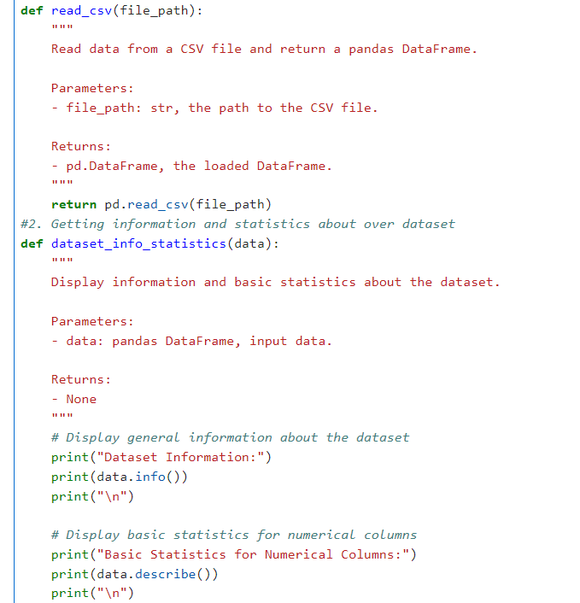

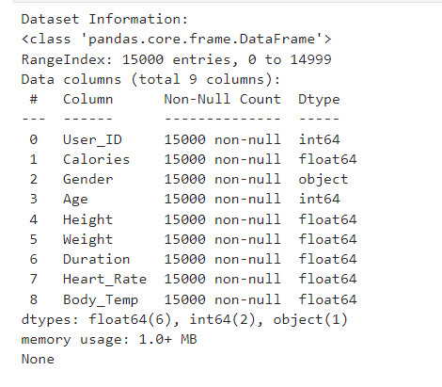
Data Manipulation and Pre-Processing

Slide 9
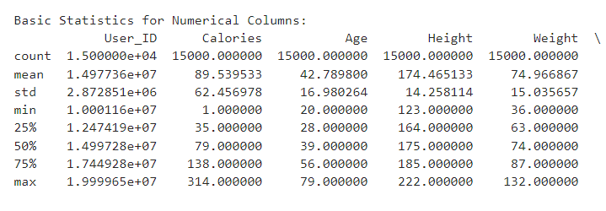
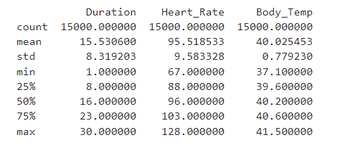
Why We Need To Normalize Deviations / Clean Datasets for Productive Model?
To assess the variability in a dataset, a standard approach is to examine the standard deviation (std), A higher standard deviation indicates that data points are more spread out from the mean, reflecting greater variability. In the given dataset we can observe the standard deviation of each column to identify where the most significant difference lie

Slide 10
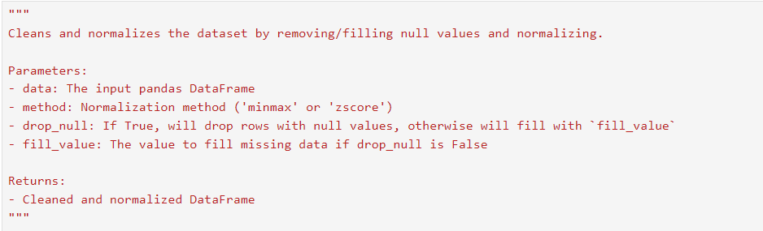
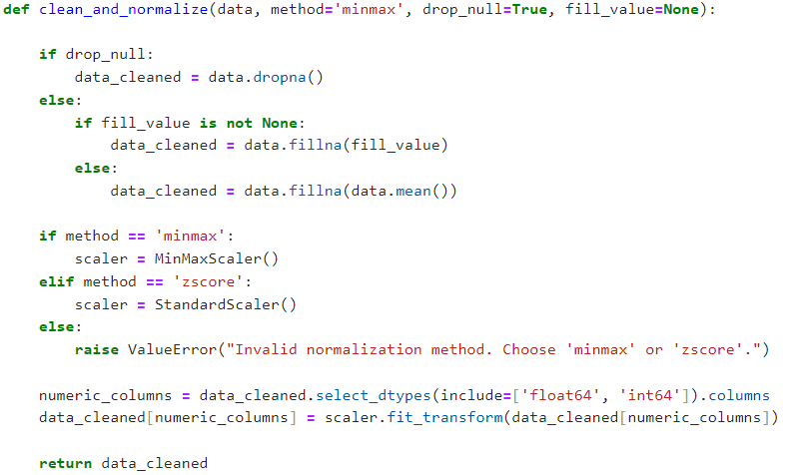
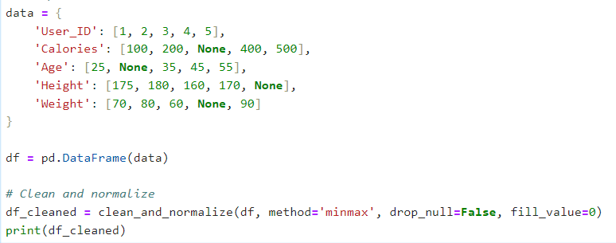
Why We Need To Normalize Deviations / Clean Datasets for Productive Model?

Slide 11
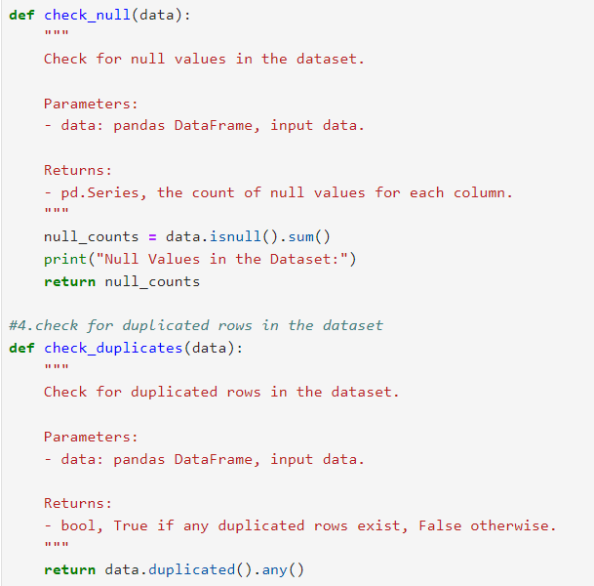
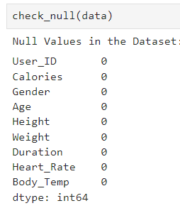
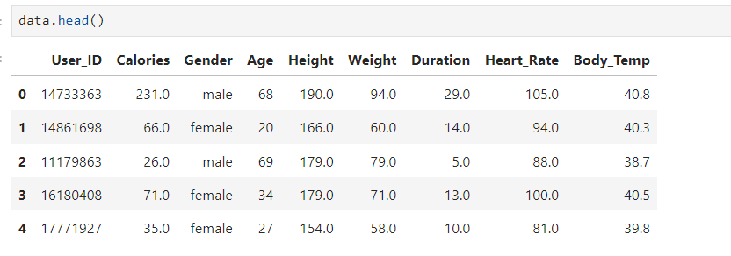
NULL & Duplicate Values Removed

Slide 12
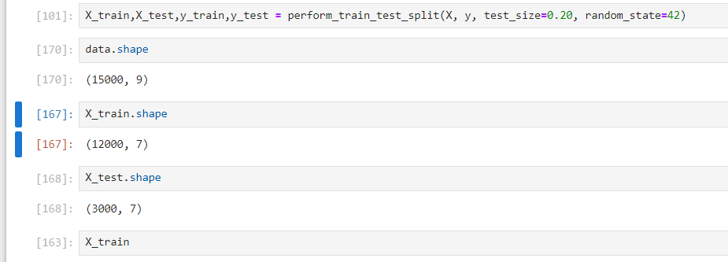
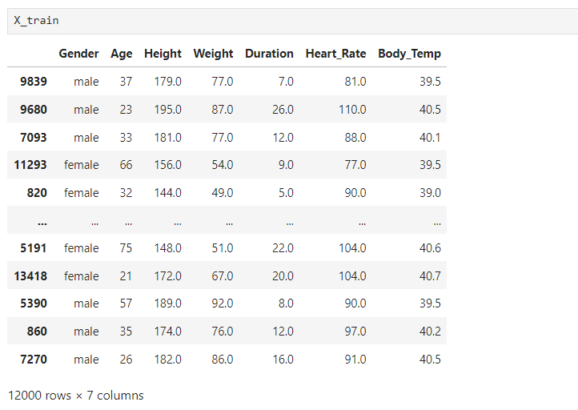
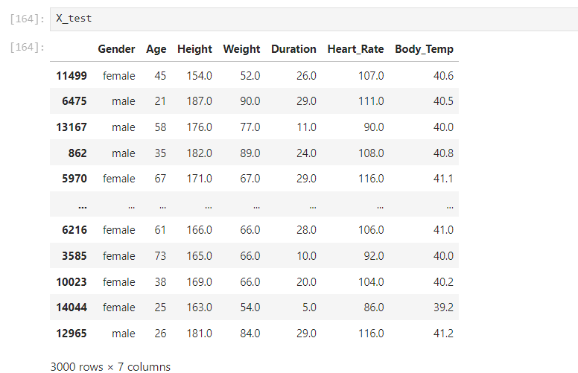
Training
vs
Testing Dataset

Slide 13


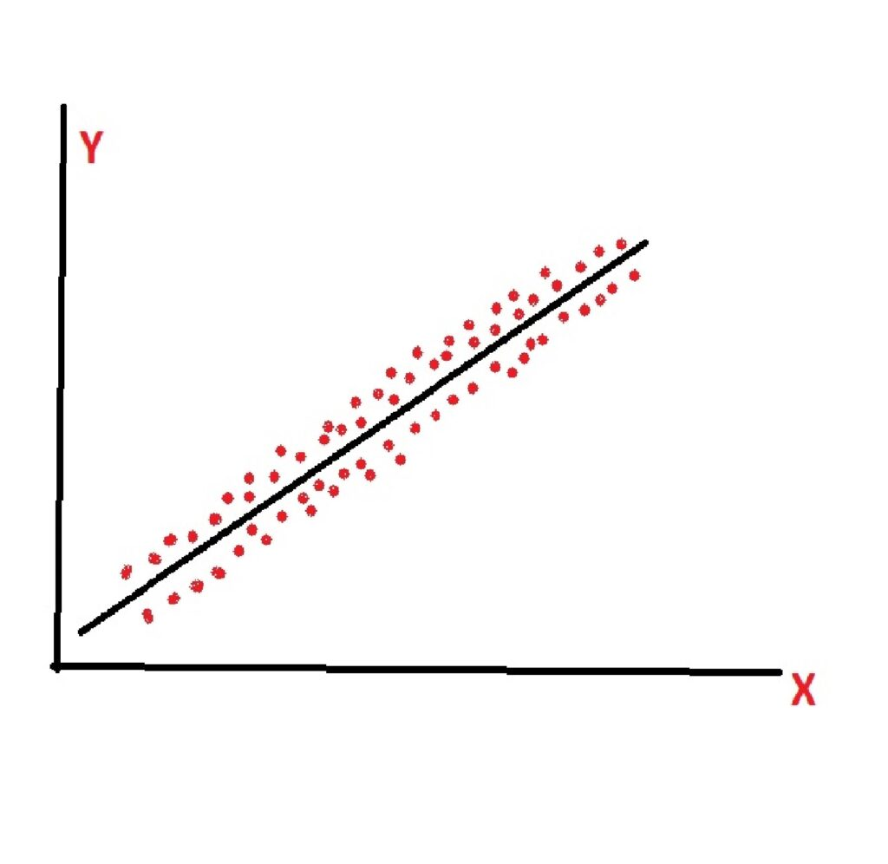


1st Training Model : Multiple Linear Regression
Single Linear Regression : In single linear regression, we model the relationship between one independent variable 𝑥 and y with a straight line. The formula for a single linear regression model is:
True Points : true points refer to the actual observed values of the target variables for each data point in a dataset. These are the real outcomes or the ground truth values that a model aims to predict.
Residual / Errors : The difference between the actual observed value and the predicted value from a model for each data point.
Our main aim is to come up with a best fit line wherein when we try to calculate or do the summation of all this error, the error should come out to be minimal.
Now we see, how our best fit line is created. And then we will try to rotate this best fit line by changing intercept and coefficient values.

Slide 14
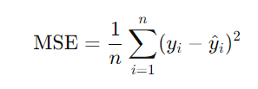
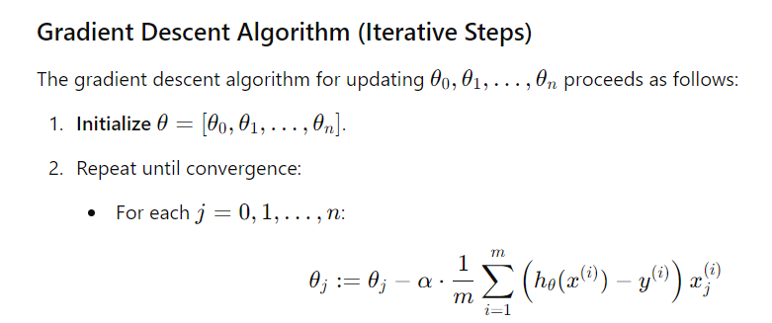


Multiple Linear Regression
Cost Function : It is a mathematical function used to measure the error or difference between the predicted value by a model and the actual values. It quantifies how well or poorly a model fits the data, guiding the optimization process to find the best model parameters.
The Mean Squared Error (MSE) measures the average of the squares of the errors – that is, the average squared difference between the predicted values and actual values. This is what Cost Function is.
The cost function for multiple linear regression is the same concept as for simple linear regression, but extended for multiple features. It is given by:
The model parameters θ are adjusted to minimize this cost function, making the predicted values as close as possible to the actual values. Since our final aim is to get minimum of Cost Function, so that we can get the best fit line by continuously changing values for all the θ coefficients.
Note : Quadratic equation of MSE is very useful for us in such terms, that it’s slope provides a Gradient Descent, which provides a global minima, including few local minima, as we need minimum values of the errors. And Outliers also play a significant role here.

Slide 15
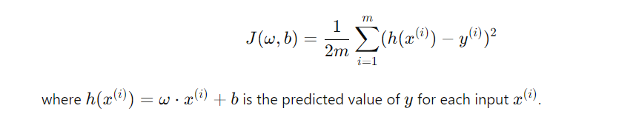
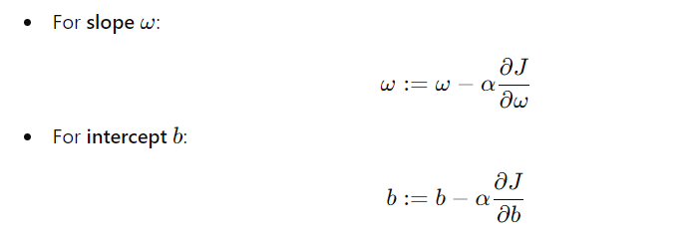
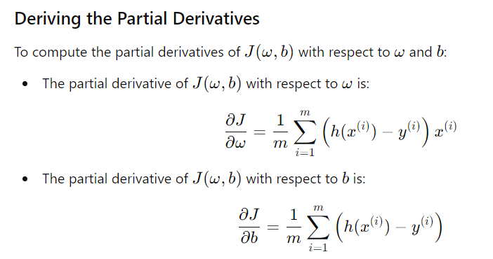
Multiple Linear Regression
Gradient Descent :
The goal in multiple linear regression is to minimize the cost function J(w,b).
Partial Derivatives provides with the direction of taking steps, also known as derivative rate.
If alpha (less/decreases) -> baby size steps [learning factor] if alpha (more/increases) -> big size steps

Slide 16
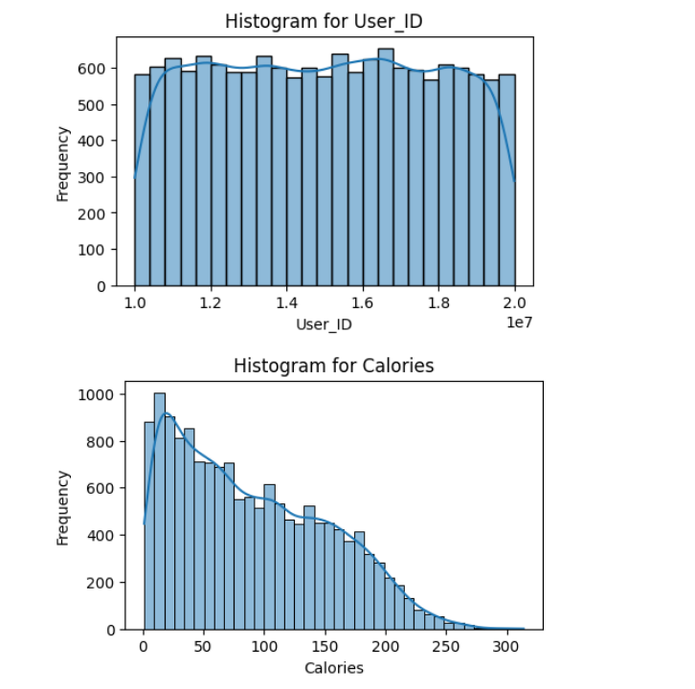
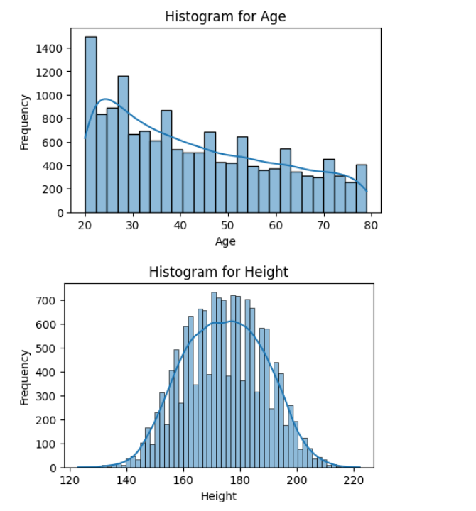
Data Visualizations: Plotting Histograms

Slide 17
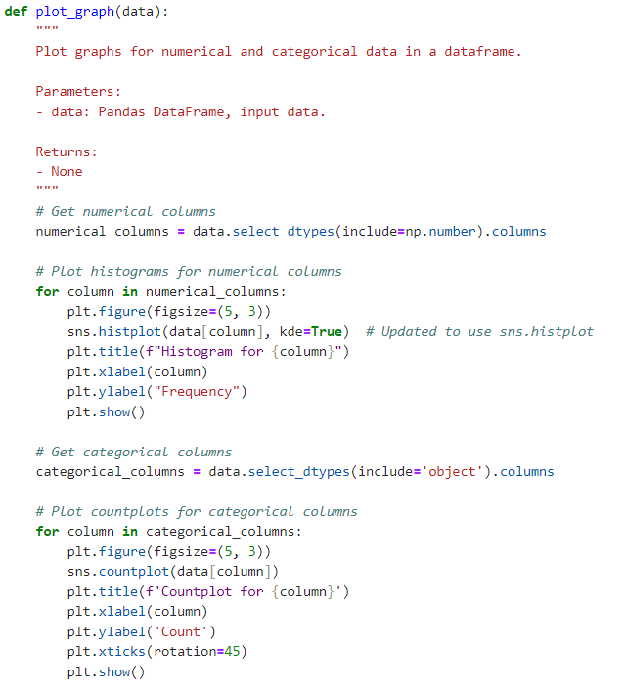
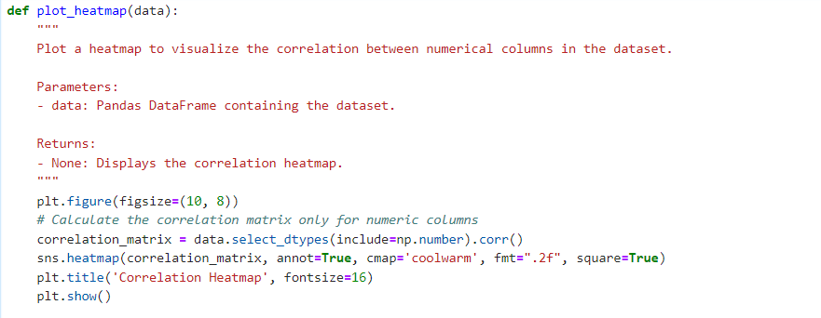
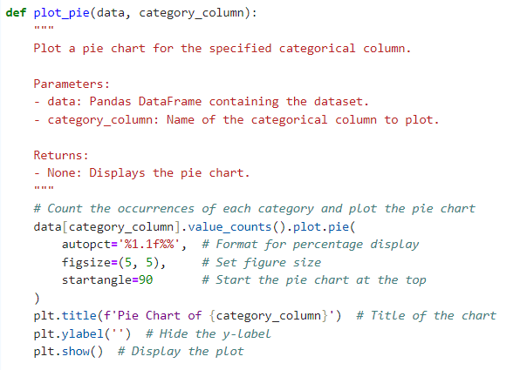
Codes For Plotting Pie Charts / heatmaps

Slide 18
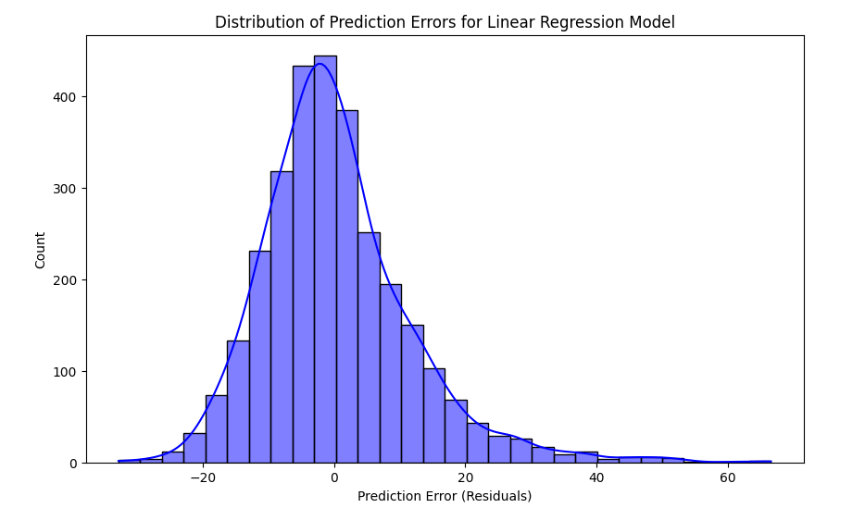
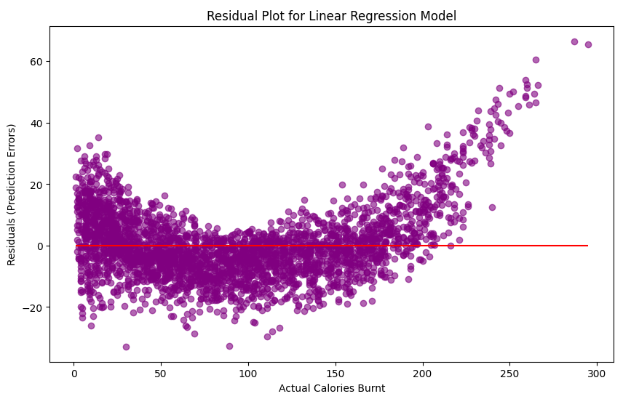
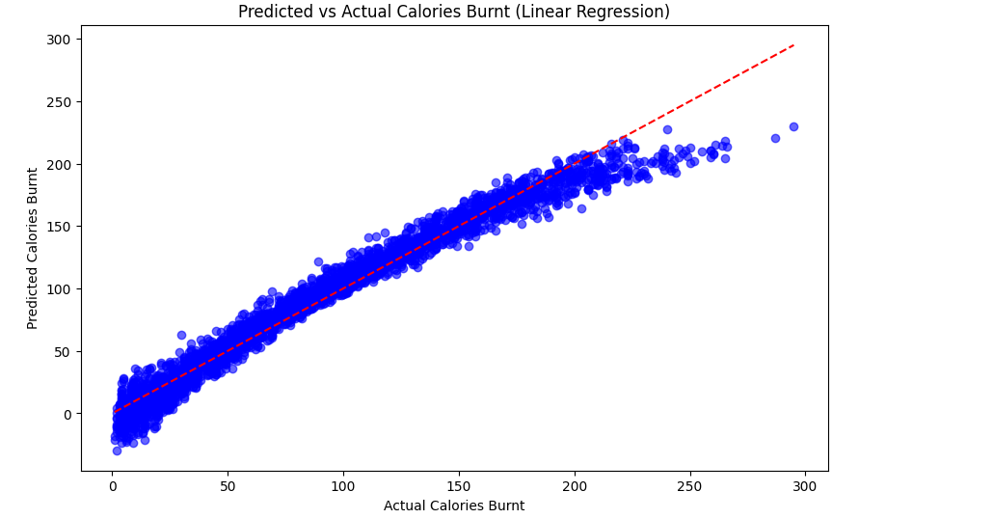
Line Plots :

Slide 19
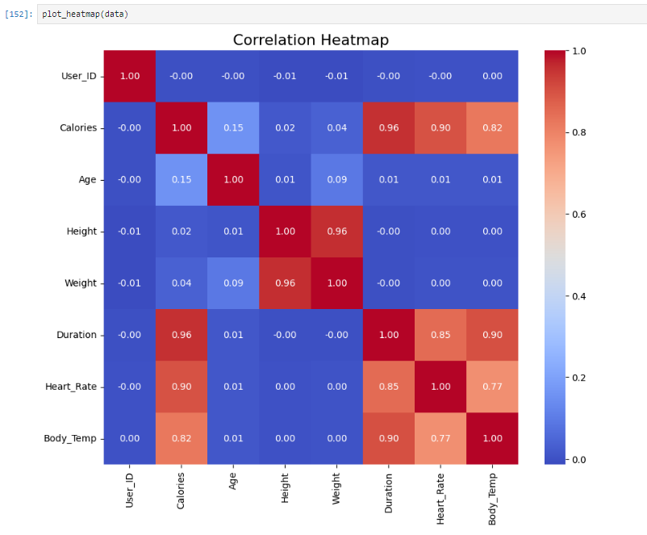


Slide 20


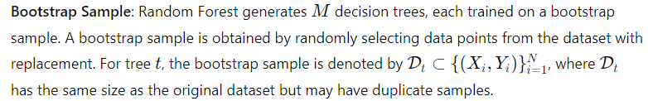
2nd Training Model : Random Forest Regressor
Random Forest is an ensemble learning method that combines the predictions of multiple decision trees.
It uses bootstrapping (random sampling with replacement) to create subsets of data, trains a decision tree on each subset, and averages their predictions.
Each tree splits the data based on feature values, reducing the error by capturing complex, non-linear relationships.\
The final prediction in regression tasks is usually the average of predictions from individual trees:
For Classification :
For Regression :

Slide 21

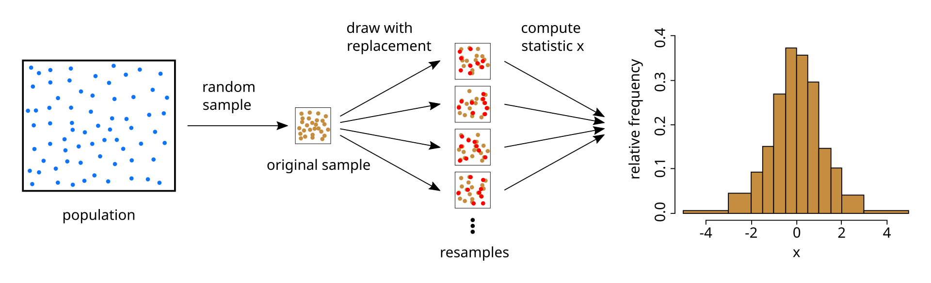
Random Forest Regressor
Ensemble Techniques :
Ensemble learning combines multiple models (base learners) to improve overall prediction accuracy and robustness. It reduces error by leveraging the collective strength of multiple models, which minimizes overfitting and enhances generalization.
Random Forest is an ensemble learning method that combines the predictions of multiple decision trees. Each tree is trained on a random subset of data. It’s particularly useful for both regression and classification tasks.
Bootstrapping : Random sampling with replacement is used to create multiple subsets of the training data.
Parallelism in Radom Forest :
Each tree in a Random Forest is trained on a different subset of data, created through bootstrapping (random sampling with replacement). Since each tree does not rely on the outcome of any other tree, they can all be trained in parallel without dependencies.

Slide 22
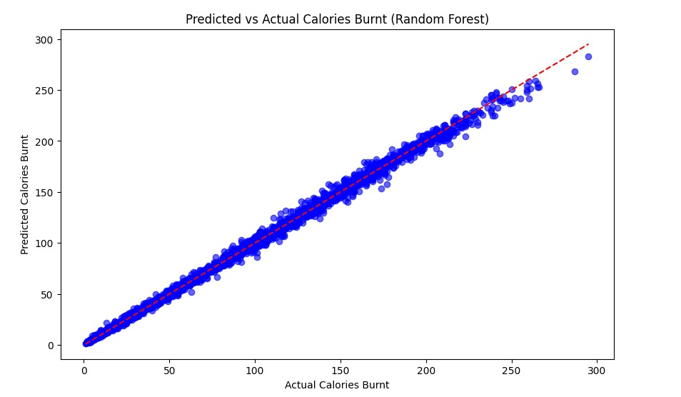
Random Forest Regressor

Slide 23
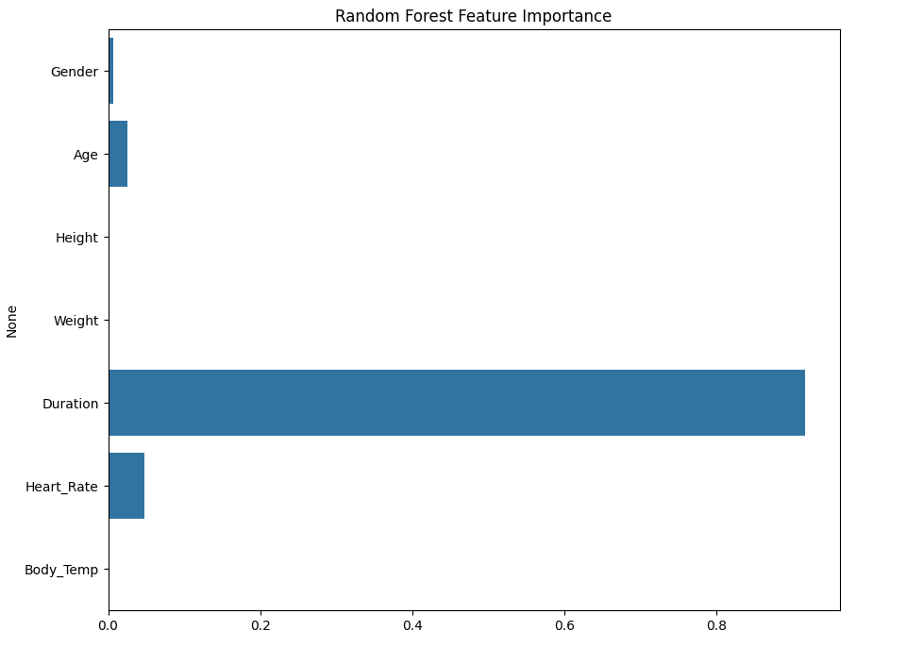
Random Forest Regressor

Slide 24
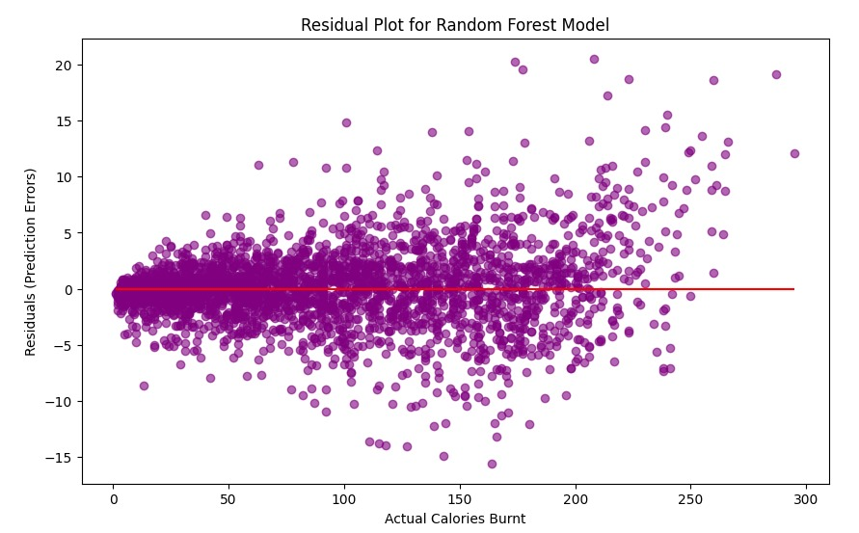
Random Forest Regressor

Slide 25
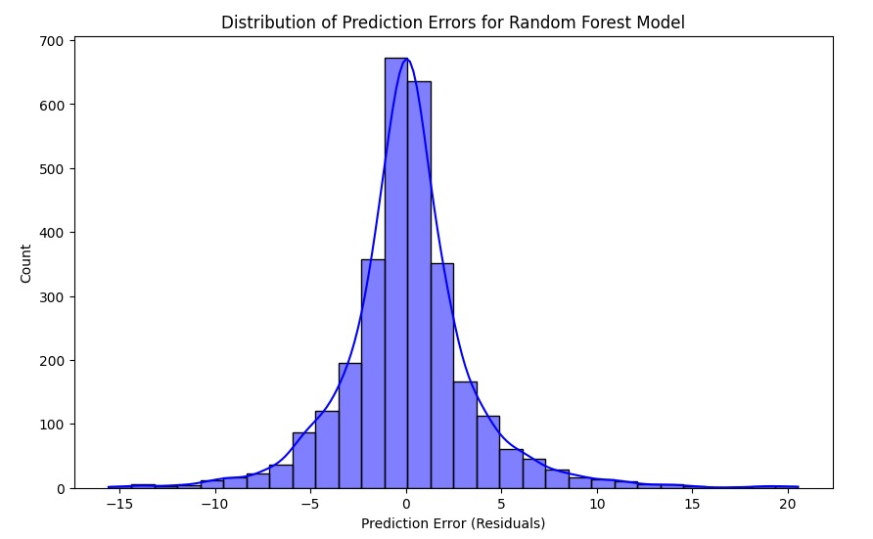
Random Forest Regressor

Slide 26
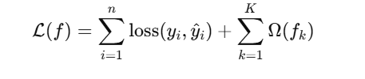


3rd Training Model :XGBoost Algorithm
Combines Multiple Decision Trees to improve prediction accuracy.
XGBoost is an optimized implementation of the gradient boosting framework, which works by building an ensemble of decision trees in a sequential manner. Each tree in the ensemble is trained to correct the errors made by previous tree, and the final prediction is made by combining the output of all the trees.
The model aims to minimize the Mean Squared Error(MSE) as the loss function, and the following formulas apply :
Residual Calculation The residuals is the difference between the actual value and the predicted values for each observation.

Slide 27
XGBoost Algorithm
Ensemble Learning:
Age>=45
Combines Multiple Decision Trees to improve prediction accuracy.
yes
No
Boosting Technique:
Combines XGBoost (eXtreme Gradient Boosting) is a highly efficient and scalable implementation of the gradient boosting framework.
Gradient Boosting builds trees sequentially, where each new tree corrects the errors previous ones by minimizing a loss function (e.g., Mean Squared Error).
XGBoost adds regularization terms to the objective function to reduce overfitting.
Height>=150
Weight>=50
yes
No
yes
No
Where :
-L(f) is the overall loss.
- Ω(fk) is the regularization term for the k-th tree.

Slide 28
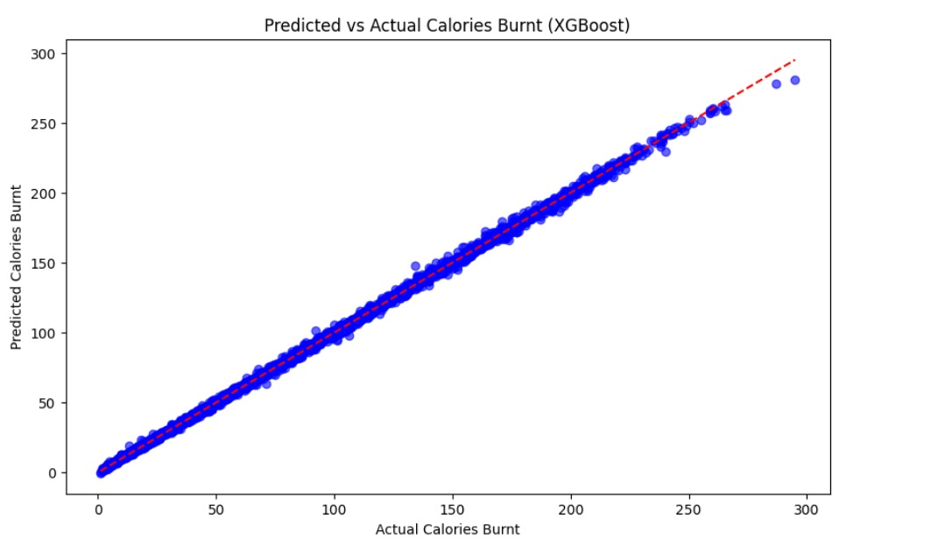
XGBoost Algorithm
Predicted Vs Actual Calories Burnt
The model is performing well, making predictions very close to the actual values. It suggests accurate predictions, low bias, and good generalization.

Slide 29
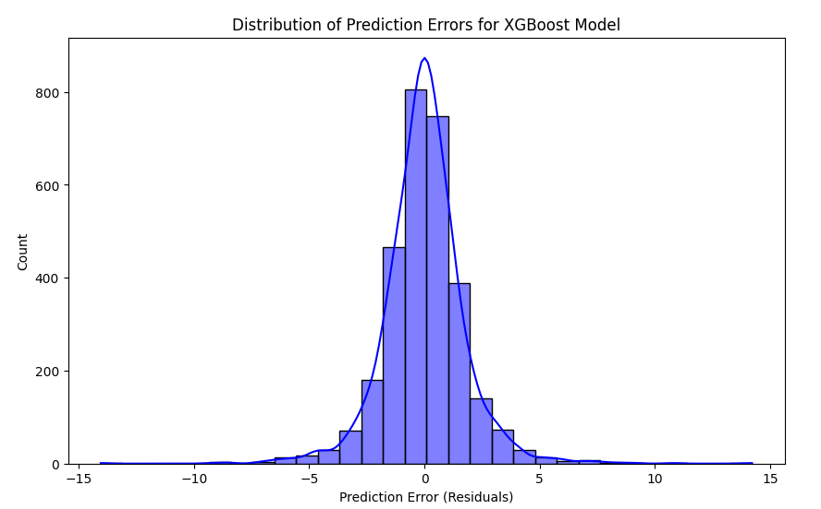
XGBoost Algorithm

Slide 30

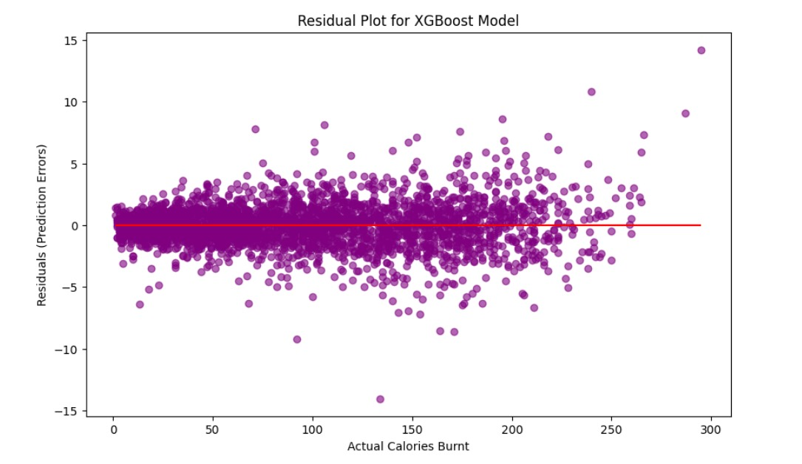
XGBoost Algorithm
This straight line in the residual plot suggests that the gradient boosting approach has effectively reduced the errors and captured the relationship, even if the underlying relationship is not strictly linear.

Slide 31
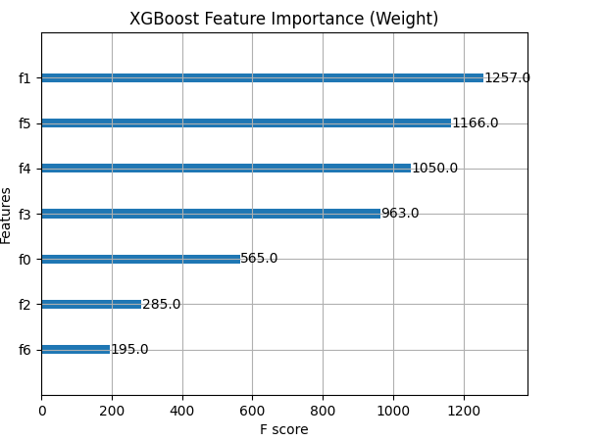
XGBoost Algorithm

Slide 32

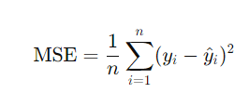


Model Performance using Several Metrics
R² Score (Coefficient of Determination)
Definition : Measures how well the model’s predictions fit the actual data. It represents the proportion of variance in the dependent variable that is predictable from the independent variables. Range : 0 to 1 (closer to 1 means a better fit)
Mean Squared Error (MSE)
Definition : Measures the average squared difference between the predicted and actual values. It penalizes larger errors more heavily due to the square. Also known as Cost Function. Range : 0 to ∞ (lower values indicate better performance)
Mean Absolute Error (MAE)
Definition : Measures the average absolute difference between predicted and actual values. MAE is less sensitive to large errors than MSE. Range : 0 to ∞ (lower values indicate better performance)
Root Mean Squared Error (RMSE)
Definition : The square root of MSE. It provides error in the same unit as the target variable. Range : 0 to ∞ (lower values indicate better performance)

Slide 33
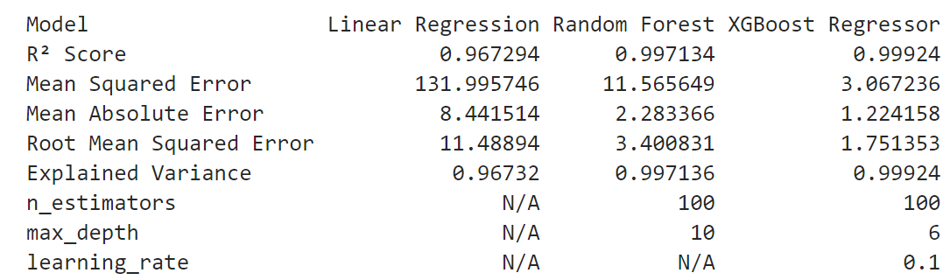
Additional Params for Tree-Based Models
n_estimators
Definition : Number of trees in the model. For Random Forest and XGBoost, increasing the number if estimators generally improves performance (up to a certain point) but also increases computation time.
max_depth
Definition : 0 to ∞ (lower values indicate better performance) Maximum depth of the tree. A higher depth allows the model to capture more complex patters but can lead to overfitting.
learning_rate
Definition : 0 to ∞ (lower values indicate better performance) Maximum depth of the tree. A higher depth allows the model to capture more complex patters but can lead to overfitting.
Step size of each iteration in the model optimization (only in XGBoost). A smaller learning rate requires more estimators to achieve a good fit.

Slide 34
Graphical User Interface
User Friendly Interface : Built with Tkinter for easy input of exercise details (age, height, weight, etc.)
Features : Predict Calories Burnt i.e., displays predicted values with a progress bar for visual feedback with almost 98-99% accuracy.
Personal Goal Tracker : Provides personalized exercise and Diet Plans based on target calories.
Designed clean aesthetic layout with consistent colors and icons for better user engagement.
Error Handling : Input Validation and clear error messages enhance reliability.
Tech : Tkinter framework, Pandas and Pickle for model training.

Slide 35
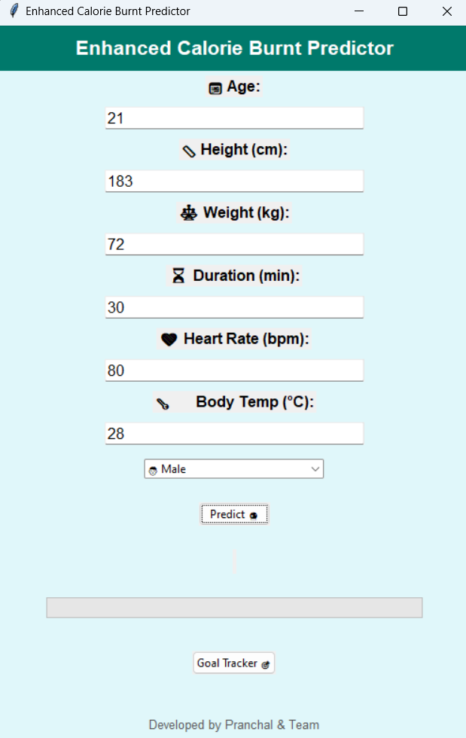
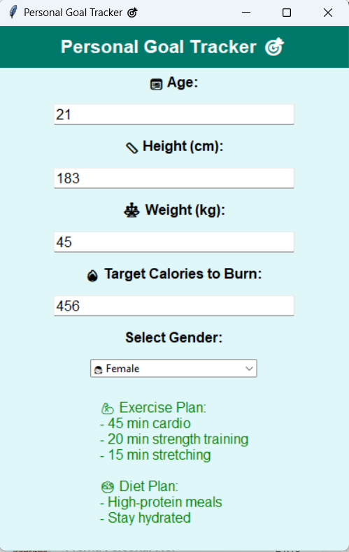
Graphical User Interface

Slide 36
Conclusion
1
Our Project successfully identified key patterns in calorie consumption and health metrics
2
Gender, age, duration and weight showed a strong influence on various health indicators.
3
The results can guide personalized fitness plans and health interventions.
4
Future work will focus on incorporating more real-time data for deeper insights.
5
This study lays the groundwork for data driven-health and fitness optimizations.

Slide 37
References
[1] D. Bubnis, “Calculating how many calo- ries are burned in a day,” Medical News Today, 01 January 2020. [Online]. Available: https:// www.medicalnewstoday.com/articles/319731.
[2] K. S. University, “Burning more calo you perceive as better,” 26 November 2012. [Online]. Available: https://www.sciencedai- ly.com/releases/2012/11/121126130938.htm.
[3] B. K. Tingley, “The New Science on How We Burn Calories,” The New Work Times Mag Current Integrative Engineering Volume 1, Issue 1 azizne, 14 September 2021. [Online]. Avail- able: https://www.nytimes.com/2021/09/14/ m a ga zin e /ca lo r ie s - we igh t - a ge . h tm l.
[4] S. T and V. K, “PREDICTION OF US- ER’S CALORIE ROUTINE USING CONVOLU- TIONAL NEURAL NETWORK,” International Journal of Engineering Applied Sciences and Technology, vol. 5, no. 3, pp. 189-195, 2020.
[5] G. vijayalakshmi and T. Sridur- ga, “COMPARING MACHINE LEARNING AL- GORITHMS FOR PREDICTING CALO- RIES BURNED,” JOURNAL OF EMERGING TECHNOLOGIES AND INNOVATIVE RESEARCH (JETIR), vol. 10, no. 3, pp. 519-527, March 2023.

Slide 38
THANK YOU !

